Slide 1
Social Media & Mental Health Dashboard
Correlation Between Screen Time and Well-Being
Presented By: Jibin K B
December 2025

Slide 2
Introduction
Mental health challenges are becoming increasingly common, especially among young people worldwide. At the same time, social media and digital devices have become an unavoidable part of daily life, influencing emotions, habits, and lifestyle.

Slide 3
Introduction
This project investigates the relationship between screen time and mental well-being, using data visualization to uncover how sleep, stress, happiness, and daily habits are impacted by prolonged device use
The aim is to transform raw survey data into meaningful insights that support healthy digital behavior.

Slide 4
Objectives of the Study
This study focuses on:
Identifying patterns between screen time and mental well-being — Sleep quality, stress levels, happiness & productivity
Analyzing variations across age groups — Understanding which groups are most affected
Measuring lifestyle changes linked to mobile usage — Exercise frequency, social interaction & sleep routine
Presenting findings through an interactive dashboard — Designed using Excel (Pivot Tables, Slicers & Charts)

Slide 5
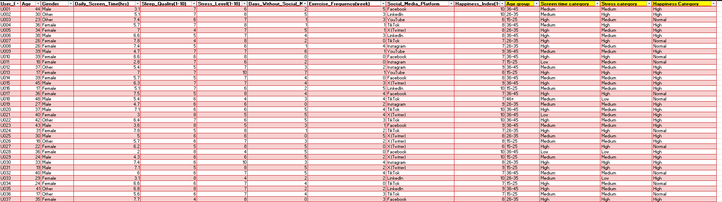
Dataset Details

Slide 6
Dataset Details
This dataset captures the delicate relationship between social media habits and mental well-being.
It combines variables such as screen time, stress level, sleep quality, digital detox days, and happiness index.

Slide 7
Data Preparation
Created Age Group buckets (18–25, 26–35, 36–45,46+)
Added Screen Time Category based on daily hours (Low / Medium / High)
Added Stress Category based on reported stress levels
Added Happiness Category derived from Happiness Index

Slide 8
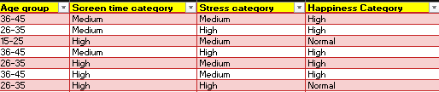
Data Preparation
Column names in the original dataset
New calculated columns

Slide 9
Tools Used
Primary Tool:
Microsoft Excel
Features Utilized:
Pivot Tables — for summarizing metrics (screen time, stress, sleep etc.)
Slicers — for interactive filtering by age group, gender & wellness category
Charts & Visualizations — bar chart, line chart, pie chart to display insights

Slide 10
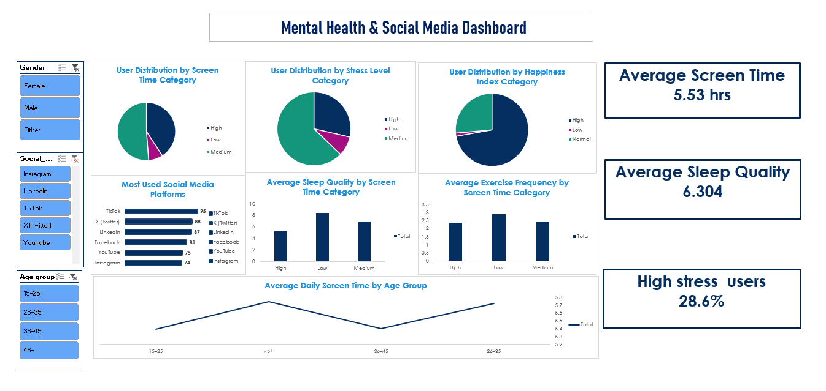
Dashboard Overview

Slide 11
Insights & Highlights
Most users belong to Medium and High screen-time groups, indicating that digital consumption is a major part of the daily routine for the majority of respondents
Stress levels rise with screen exposure — Medium and High stress categories dominate among users who spend longer hours on screens
Happiness levels are mixed, suggesting that social media contributes both positively and negatively

Slide 12
Insights & Highlights
YouTube, Instagram & TikTok are the most consumed platforms, which correlate with higher screen time compared to professional platforms like LinkedIn.
Higher screen time negatively impacts sleep quality — users in the High screen-time category report the poorest sleep ratings.
Physical activity decreases as screen time increases, implying reduced exercise frequency due to extended device usage.

Slide 13
Conclusions & Recommendations
Conclusions
Screen time has a strong influence on mental well-being — users with higher screen time show higher stress and lower sleep quality
Productivity and physical activity decrease as screen hours increase, affecting overall lifestyle balance
Social media platforms that promote continuous scrolling (YouTube, Instagram, TikTok) are linked to longer usage durations

Slide 14
Conclusions & Recommendations
Recommendations
Limit daily screen time to under 4 hours to maintain healthy stress and sleep levels
Follow digital detox habits, especially before bedtime, to improve sleep quality
Encourage offline physical activities — sports, outdoor breaks, and social interaction to balance digital habits

Slide 15
Reference
P. Rajak, “Mental Health & Social Media Balance Dataset,” Kaggle,. [Online]. Available:Dataset source
Accessed: Dec. 4, 2025

